Slide 1
Module 1 :Introduction and Basic Information about Indian Constitution
Constituion– set of rules and regulations which speaks about the governing framework of the country, rights and duties of the people.
Making of the Constitution –
Govt. of India Act 1935
Ganhiji’s declaration of Swaraj
Nehru’s declaration of Fundamental Rights
Cripps Proposal, 1942
Cabinet Mission Plan, 1946
Constituent Assembly, 1946,
Chairman: Dr. Rajendra Prasad
Draftig Committee chairman – Dr. B.R.Ambedkar
Adopting of the Constitution – 26th Novemner 1949
Commencement of the Constitution – 26th January 1950
395 Articles, 22 Parts and 8 Schedule
447 Articles, 26 Parts and 12 Schedule
Tejaswini.B,J, Assistant Professor

Slide 2
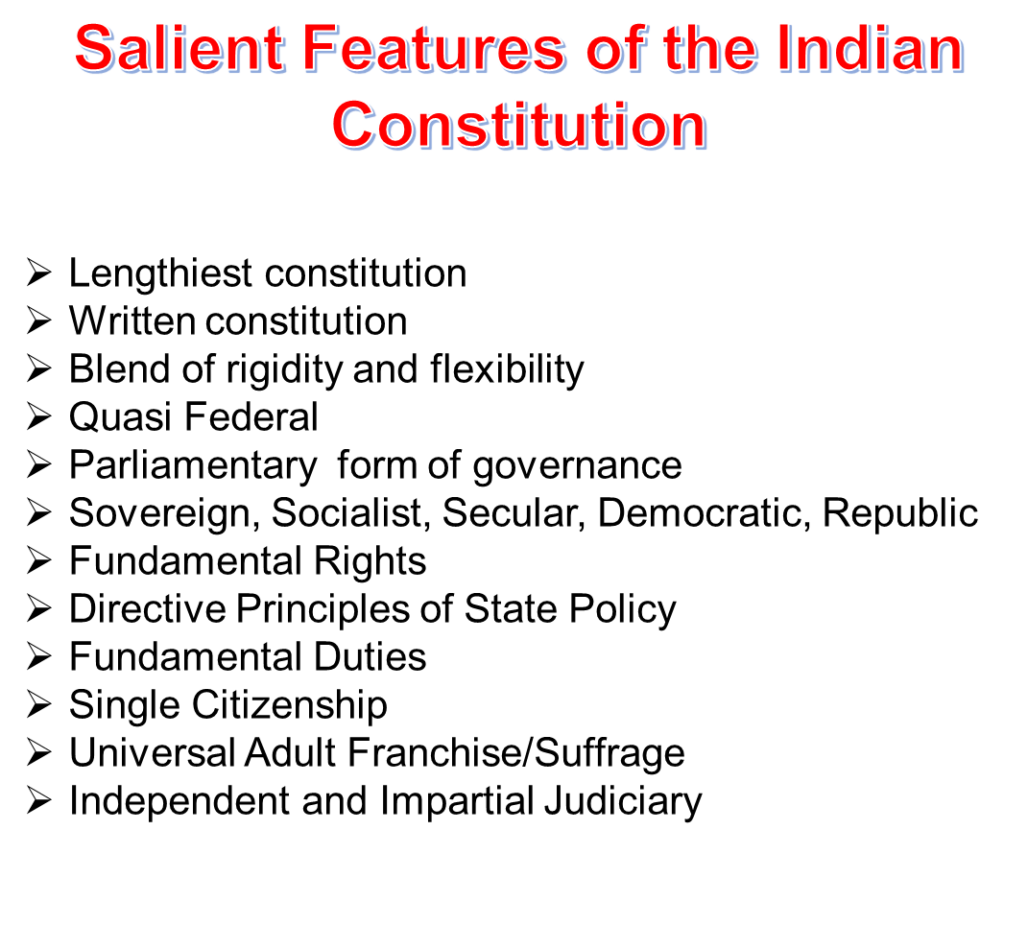
Tejaswini.B,J, Assistant Professor

Slide 3
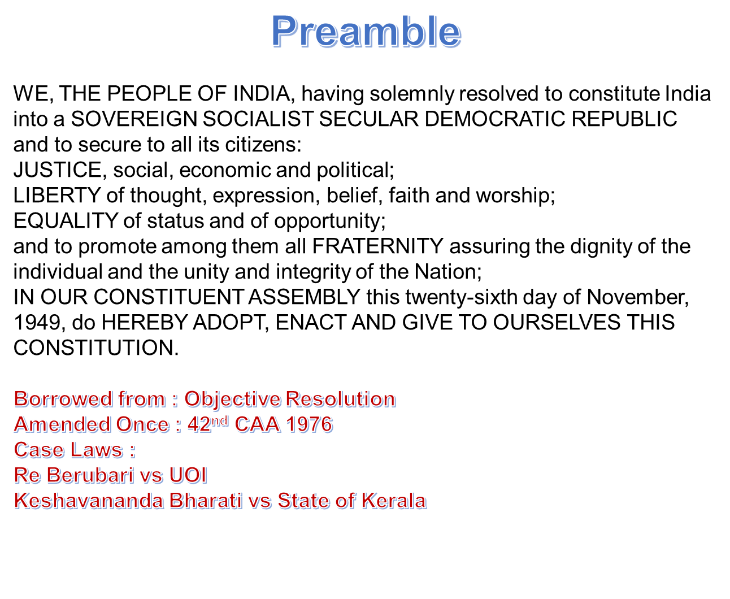
Tejaswini.B,J,
Assistant Professor

Slide 4
Fundamental Rights, Part III, Articles 12 to 35
Adopted from the constitution of USA
Magna Carta
Grouped into 6 categories
Right to Equality, Arts 14 to 18, Case laws : Mandal Commission Case
Right to freedom, Arts 19 to 22, Case Laws : Maneka Gandhi case, Mohini Jain Case
Right against exploitation, Arts 23 to 24
Right to religion, Arts 25 to 28
Cultural and Educational Rights, Arts 29 to 30
Right to constitutional remedies, Art 32,
Right to property was removed from Fundamental rights category through 44th Constitutional Amendment Act, 1978
Tejaswini.B,J, Assistant Professor

Slide 5
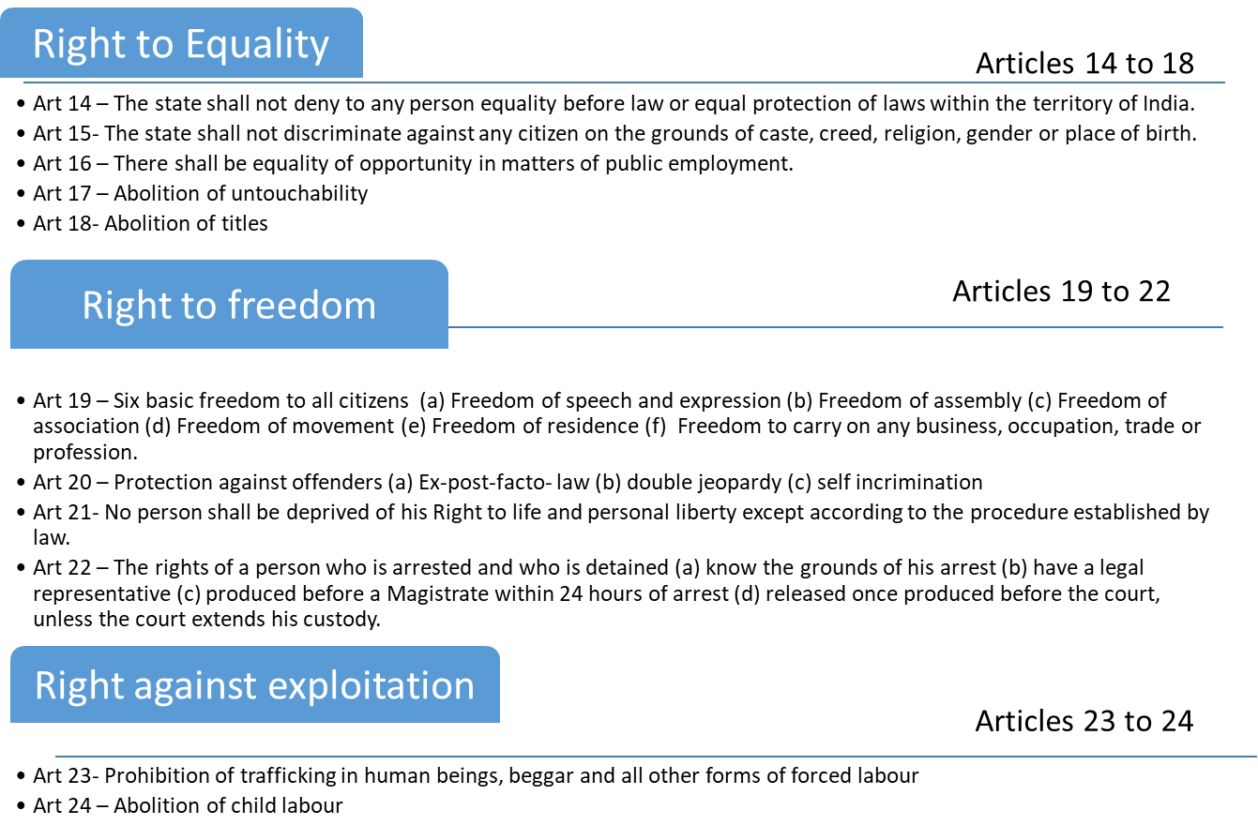
Tejaswini.B,J, Assistant Professor

Slide 6
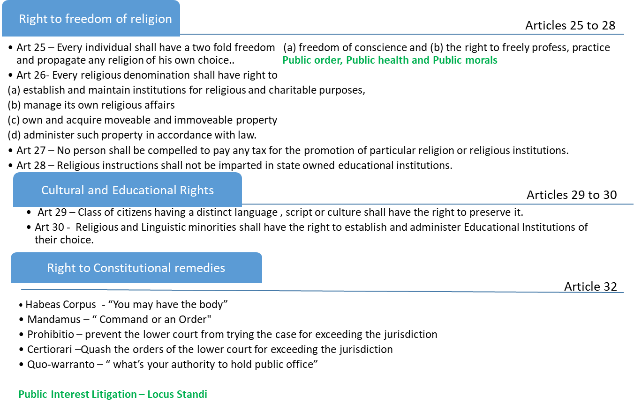
Tejaswini.B,J, Assistant Professor

Slide 7
Directive Principles of State Policy, Part IV, Articles 36 to 51
A set of guidelines or instructions given by the constitution to the state to achieve a welfare state.
Adopted from constitution of Ireland
Non justifiable in nature
Grouped into 3 categories
Socio Economic Charter, Arts 38 and 39
Socio Security Charter, Arts 39A, 41, 42, 43, 43A, 45, 46 and 47
Community Welfare Charter, Arts 40, 44, 48, 48A, 49, 50 and 51
Tejaswini.B,J, Assistant Professor

Slide 8
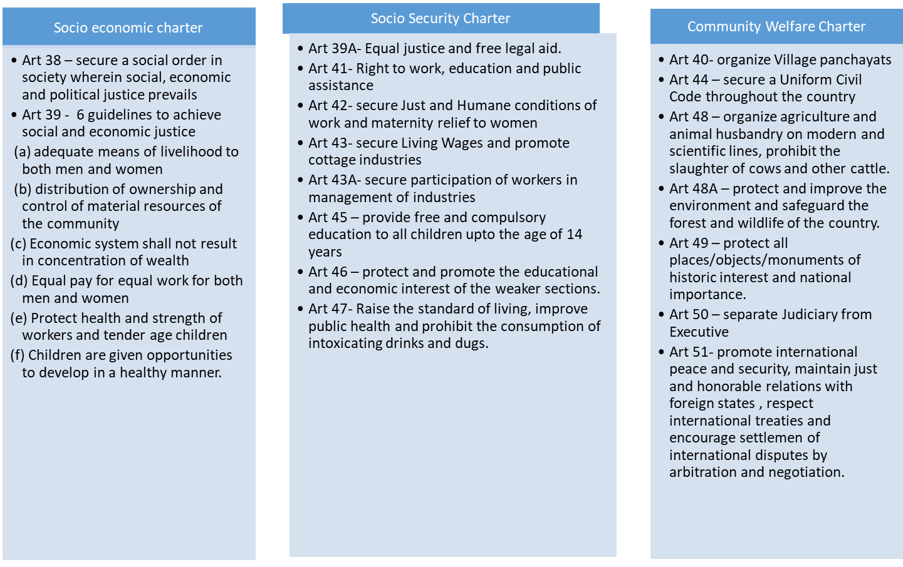
Tejaswini.B,J,
Assistant Professor

Slide 9
Fundamental Duties, Part IV A, Art 51 A
Added in 1976 through 42nd CAA on the recommendation of Swarn Singh Committee.
Adopted from the Constitution of USSR
Non- justifiable in nature
11 Fundamental duties, 11th was added through 86th CAA 2002
To abide by the Constitution and respect its ideals and institutions, the National Flag and the National Anthem;
To cherish and follow the noble ideals which inspired our national struggle for freedom;
To uphold and protect the sovereignty, unity and integrity of India
To defend the country and render national service when called upon to do so
To promote harmony and the spirit of common brotherhood amongst all the people of India transcending religious, linguistic and regional or sectional diversities; to renounce practices derogatory to the dignity of women;
To value and preserve the rich heritage of our composite culture
Tejaswini.B,J, Assistant Professor

Slide 10
To protect and improve the natural environment including forests, lakes, rivers, wildlife and to have compassion for living creatures
To develop the scientific temper, humanism and the spirit of inquiry and reform;
9. To safeguard public property and to abjure violence
10. To strive towards excellence in all spheres of individual and collective activity so that the nation constantly rises to higher levels of endeavour and achievement
11. Who is a parent or guardian, to provide opportunities for education to his child, or as the case may be, ward between the age of six to fourteen years.
Tejaswini.B,J, Assistant Professor

